Slide 1

P peline
The Data
Networks
© Jennifer Mankoff
The Data Pipeline; HCII; Spring 2014

Slide 2
Goals for Today
Review last lecture
Quiz 7 answers
Quiz 8
Discussion of network science
Byte 6 Alternate

Slide 3
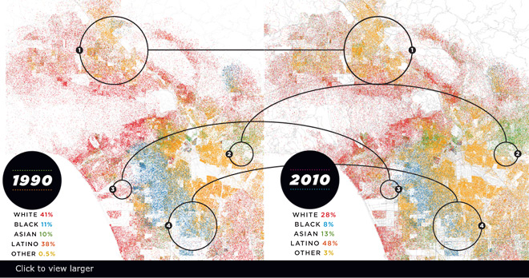
Visualizing Big Data
Make use of every pixel
Notes:
----- Meeting Notes (3/26/15 09:10) -----
storytelling

Slide 4
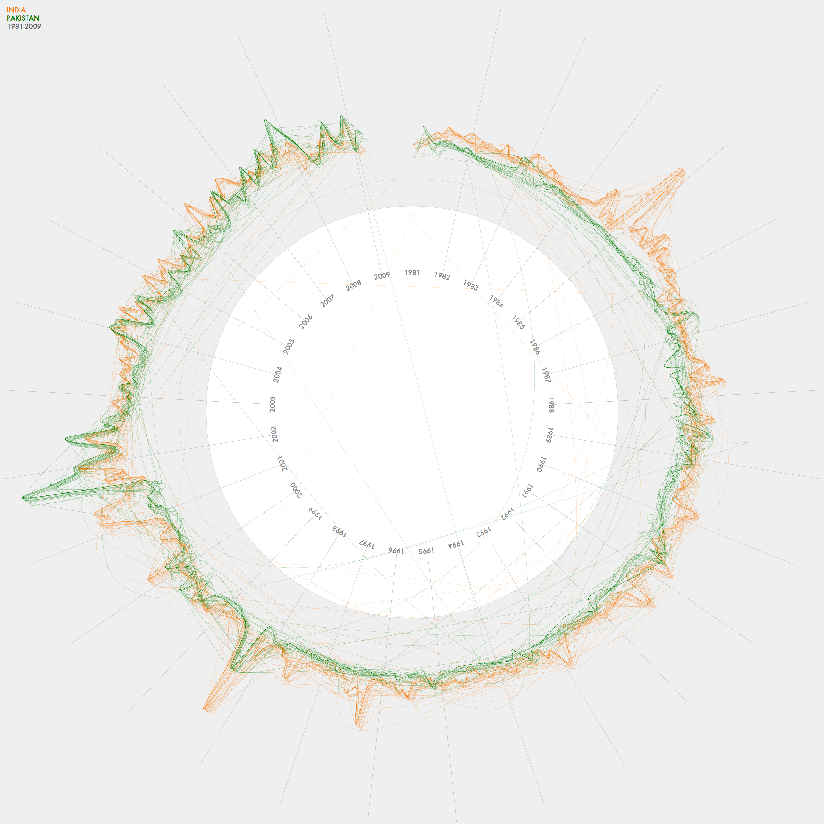
Visualizing Big Data
Make use of every pixel
Use color and location to break the data up and allow the viewer to easily filter

Slide 5
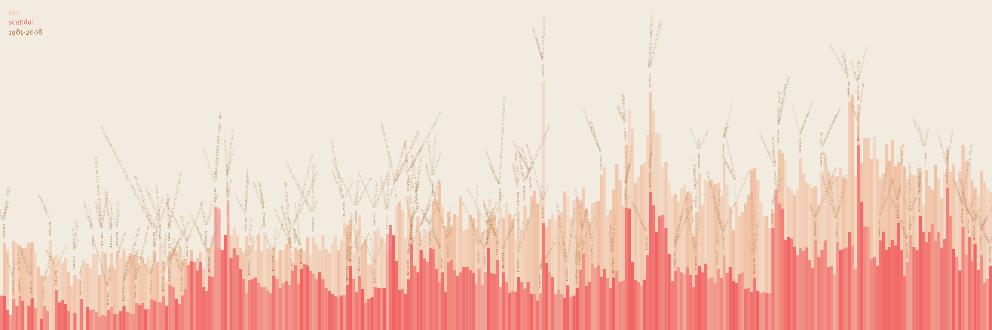
Visualizing Big Data
Make use of every pixel
Use color and location to break the data up and allow the viewer to easily filter
Give a sense of things and use zooming for detail

Slide 6
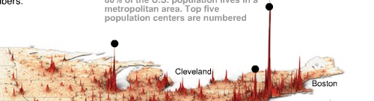
Visualizing Big Data
Make use of every pixel
Use color and location to break the data up and allow the viewer to easily filter
Give a sense of things and use zooming for detail
Add a dimension such as time or height for a key variable

Slide 7
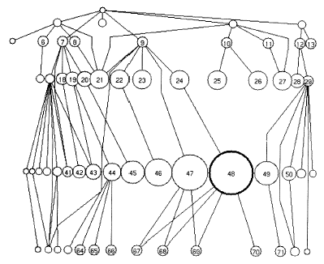
Visualizing Big Data
Make use of every pixel
Use color and location to break the data up and allow the viewer to easily filter
Give a sense of things and use zooming for detail
Add a dimension such as time or height for a key variable
Allow exploration through distortion, filtering, highlighting, and linking

Slide 8
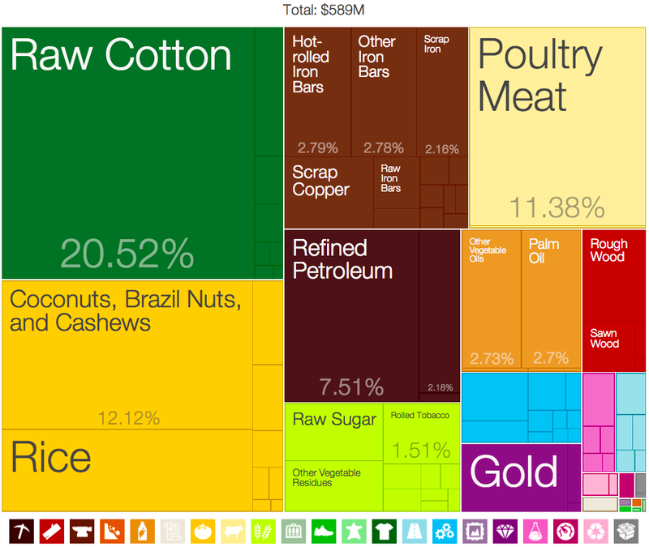
Visualizing Big Data
Make use of every pixel
Use color and location to break the data up and allow the viewer to easily filter
Give a sense of things and use zooming for detail
Add a dimension such as time or height for a key variable
Allow exploration through distortion, filtering, highlighting, and linking
Exploit hierarchy and connectivity

Slide 9
Goals for Today
Review last lecture
Quiz 7 answers
Quiz 8
Discussion of network science
Byte 6 Alternate
Notes:
----- Meeting Notes (3/26/15 09:23) -----
byte 6: move deadline 'til tuesday

Slide 10
Goals for Today
Review last lecture
Quiz 7 answers
Quiz 8
Discussion of network science
Byte 6 Alternate

Slide 11
Very multidisciplinary field
Fields that contribute to network science
computer science
applied mathematics
operations research
physics
economics
sociology
Based much of this material on Easley & Kleinberg (excellent, free online book): Networks, Crowds & Markets
Notes:
Networks, Crowds, and Markets:
Reasoning About a Highly Connected World

Slide 12
What is a network?
Notes:
Nodes, links? Paths…
List 3
Many scales of influence
cellular network is a prerequisite of life
neural network (brain)
social network
Communication networks
power grid
Trade networks
www

Slide 13
What is a network?
Pick one
What are the nodes?
What are the links?
How would you go about mapping it out? Can it be?
Why do you care about it
[discuss with a neighbor]
Notes:
Nodes, links?

Slide 14
Types of networks
Collaboration graphs record who works with whom in a specific setting. Nodes are people, edges are shared work

Slide 15
Types of networks
Collaboration graphs
Who-talks-to-Whom graphs (could be call graphs; face-to-face; im data; …). Nodes are people, edges are communications

Slide 16
Types of networks
Collaboration graphs
Who-talks-to-Whom graphs
Information Linkage graphs such as the web or citations have info as nodes, and links as edges

Slide 17
Types of networks
Collaboration graphs
Who-talks-to-Whom graphs
Information Linkage graphs
Physical networks such as interconnected computers, cities & roads have physical things as nodes and various edges

Slide 18
Types of networks
Collaboration graphs
Who-talks-to-Whom graphs
Information Linkage graphs
Physical networks
Natural World networks include food webs (who eats whom) or the brain’s neural connections

Slide 19
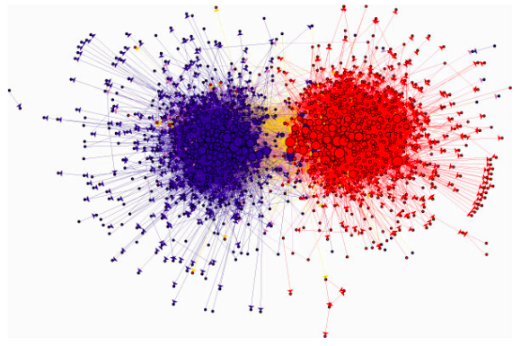
Network Structure is … Revealing
Notes:
the network structure of political blogs prior to the 2004 U.S. Presidential
election reveals two natural and well-separated clusters. (Image from http://wwwpersonal.umich.edu/
ladamic/img/politicalblogs.jpg)

Slide 20
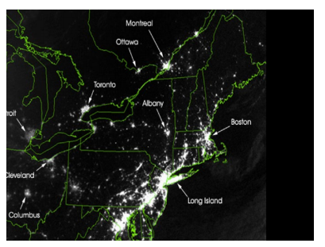
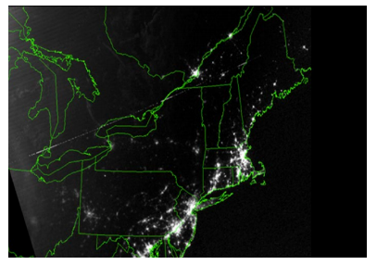
Network Structure is … Reactive
One change affects others
Relationships are complex
Notes:
Things that happen in one place affect others … memes…
Changes in a product, a Web
site, or a government program can seem like good ideas when evaluated on the assumption
that everything else will remain static, but in reality such changes can easily create incentives
that shift behavior across the network in ways that were initially unintended.
Cascading power outage example here

Slide 21
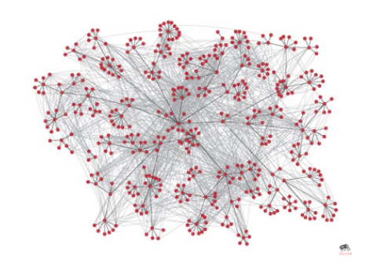
What do we want to know about a network?
corporate e-mail communication network
Notes:
This is layered over the corporate hierarchy

Slide 22
Measuring Connectivity
Important to know about groups within a network. How big? Are there many or just one? Which people are central to those groups?
Notes:
This is layered over the corporate hierarchy

Slide 23
Measuring Connectivity
Important to know about groups within a network. How big? Are there many or just one? Which people are central to those groups?
Many algorithms for this
Notes:
This is layered over the corporate hierarchy

Slide 24
Measuring Connectivity
Important to know about groups within a network. How big? Are there many or just one? Which people are central to those groups?
Cliques describe people all connected to each other (maybe by a short path
Notes:
This is layered over the corporate hierarchy

Slide 25
Measuring Connectivity
Important to know about groups within a network. How big? Are there many or just one? Which people are central to those groups?
Cliques describe people all connected to each other (maybe by a short path
Cores describe people all connected to at least k other people in the same group [we will use the k-core algorithm in Byte 6]
Notes:
This is layered over the corporate hierarchy
When applied to the graphical analysis of real and computer-generated networks, kcore visualization allows the identification of networks’ fingerprints, according to properties such as hierarchical arrangement, degree correlations and centrality.

Slide 26
Measuring Connectivity
Important to know about groups within a network. How big? Are there many or just one? Which people are central to those groups?
Cliques describe people all connected to each other (maybe by a short path
Cores describe people all connected to at least k other people in the same group [we will use the k-core algorithm in Byte 6]
Components subgraphs that are not connected with each other
Notes:
This is layered over the corporate hierarchy

Slide 27
What do we want to know about a network?
corporate e-mail communication network
strong Ties vs weak ties
Strong ties vs weak ties
Notes:
How the communication is balanced between staying within small organizational units and cutting
across organizational boundaries.
dense pockets of strong ties

Slide 28
Why is this important?
Structure matters
Gaps in connectivity may need fixing
Weak ties can act as ‘shortcuts’
Notes:
‘structural holes

Slide 29
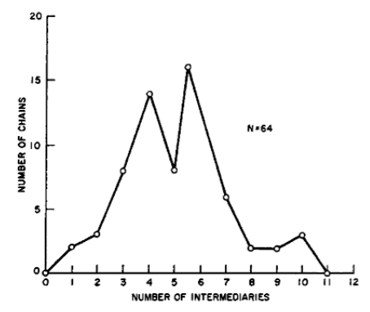
Why is this important?
Structure matters
Gaps in connectivity may need fixing
Weak ties can act as ‘shortcuts’
-> 6 degrees of separation
Notes:
A histogram from Travers and Milgram’s experiment: gave a letter to 296 ‘starters’ and asked them to get it to a man in boston…
if we think of each person as the center of their own social “world,” then “six short steps” becomes “six worlds
apart” — a change in perspective that makes six sound like a much larger number.

Slide 30
What do we want to know about a network?
corporate e-mail communication network
strong Ties vs weak ties
Central nodes
Notes:
How the communication is balanced between staying within small organizational units and cutting
across organizational boundaries.
dense pockets of strong ties

Slide 31
What do we want to know about a network?
corporate e-mail communication network
strong Ties vs weak ties
Central node
Notes:
How the communication is balanced between staying within small organizational units and cutting
across organizational boundaries.
dense pockets of strong ties

Slide 32
What do we want to know about a network?
corporate e-mail communication network
strong Ties vs weak ties
Not connected
Notes:
Could represent a conflict

Slide 33
Why is this important?
Structure matters
Gaps in connectivity may need fixing
Weak ties can act as ‘shortcuts’
-> 6 degrees of separation
Balance can be used to reason about fissures and how local issues (such as antagonism) can affect structure
Notes:
‘structural holes

Slide 34
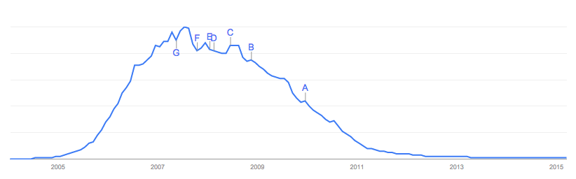
What do we want to know about a network?
Myspace searches (and related news events)
Notes:
How the communication is balanced between staying within small organizational units and cutting
across organizational boundaries.
dense pockets of strong ties

Slide 35
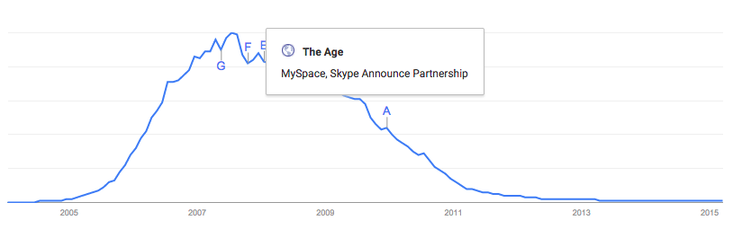
What do we want to know about a network?
Myspace searches (and related news events)
Notes:
Uneven decline, slower decline than rise… news (and other people joining) represent influence…
[also note how this is a summary statistic for the network]

Slide 36
Why is this important?
Structure matters
Game theory explores issues such as influence
Notes:
news (and other people joining) represent influence…
Questions to ask: What influences? Why?

Slide 37
Why is this important?
Structure matters
Game theory explores issues such as influence
Behavior conveys information -> information cascades
Notes:
later decisions can be based in complex ways on a mixture of private information and inferences from what has already happened… so not necessarily very good info

Slide 38
Why is this important?
Structure matters
Game theory explores issues such as influence
Behavior conveys information -> information cascades
Behavior conveys value -> network effects [e.g. rich get richer]
Notes:
Example: more people using facebook makes facebook more useful

Slide 39
Measuring Popularity
What is the distribution of in-links to nodes in a network?
[think about distributions we’ve studied…]
[does this correspond to the central limit theory?]
Notes:
e.g. how many web pages have 1 in link, 2, 3, … up to whatever the maxmimum is?
Normal distribution? if central limit – many random, independent samples
.. NO
Poisson distribution? (independent + occur at a constant rate)?
.. NO

Slide 40
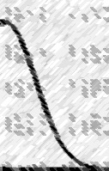
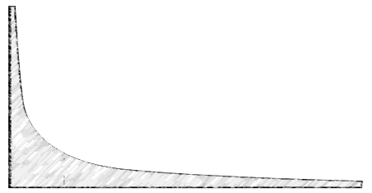
Measuring Popularity
What is the distribution of in-links to nodes in a network?
the fraction of Web pages that have k in-links is approximately proportional to 1/k²
In contrast, a normal distribution decreases by 1/2^{-k} (much faster!)
^{vs}
Notes:
Also applies in many other domains (books bought by k people; phone numbers called k x per day; scientific paper citations; …)
… seem to dominate whenever we are measuring something corresponding to popularity.
----- Meeting Notes (3/26/15 10:10) -----
normal distribution -- 2-k or 2k

Slide 41
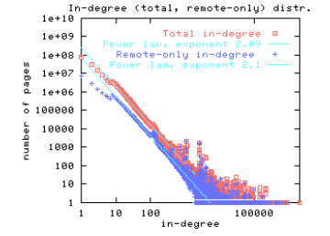
Measuring Popularity
Easy to test for power law with a log-log plot (will be a line, slope == exponent of k). [part of Byte 6]

Slide 42
Rich get Richer explanation
Power laws arise from the feedback introduced by correlated decisions across a population.
Intuition: the more popular something is, the more likely a random person is to hear about it… Math: probability 1 − p, page j chooses a page l with probability proportional to l’s current number of in-links (preferential attachment)
Notes:
Note that popularity doesn’t always stay (myspace) and that what will become popular is a bit random (study of 9 groups with the same songs – 8 came up with different popularities, tho bad songs always fared worse and good songs better; 9th couldn’t see feedback effects: Matthew Salganik, Peter Dodds, and Duncan Watts. Experimental study of inequality
and unpredictability in an artificial cultural market. Science, 311:854–856, 2006)

Slide 43
Rich get Richer explanation
Power laws arise from the feedback introduced by correlated decisions across a population
Intuition: the more popular something is, the more likely a random person is to hear about it… Math: probability 1 − p, page j chooses a page l with probability proportional to l’s current number of in-links (preferential attachment)
Intuition: thus, large values are ‘amplified’ (pages grow exponentially in popularity over time)
Notes:
Intuition: randomness has a big effect early on
Intuition: a few popular items & many less (‘long tail’)

Slide 44
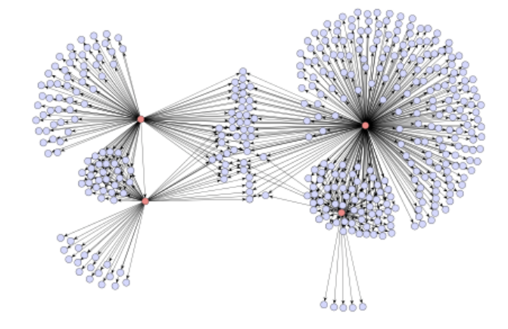
What do we want to know about a network?
Purchasers of a Japanese Graphic Novel
strong Ties vs weak ties
Just 4 nodes … big impact
Notes:
Structure and influence can interact in surprising ways

Slide 45
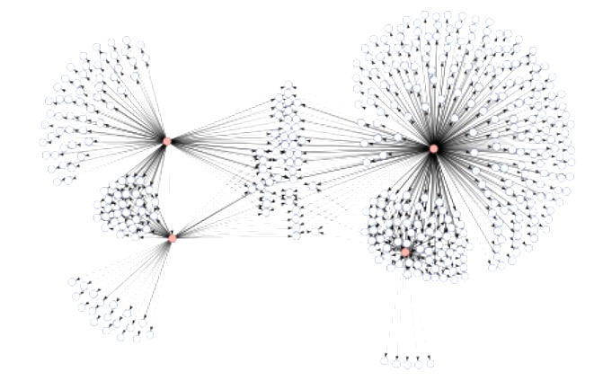
Why is this important?
Structure matters
Game theory explores issues such as influence
Structure and influence are related
Picking the right node (based on structure) changes influence
Notes:
Example: disease outbreak…

Slide 46
Other important types of network effects
How does the network as a whole behave?
e.g. financial market: individual beliefs summarized in values of assets
e.g. voting
e.g. prediction markets
Notes:
Textbook describes models that can capture all of these things based on network properties

Slide 47
Other important types of network effects
How does the network as a whole behave?
e.g. financial market: individual beliefs summarized in values of assets
e.g. voting
e.g. prediction markets
How does the network evolve over time?
e.g. the likelihood that an edge will form on two nodes that are one step apart is higher than if they are further apart (triadic closure)
Notes:
Cause one: opportunity to meet
Cause two: incentive for common node to bring them together

Slide 48
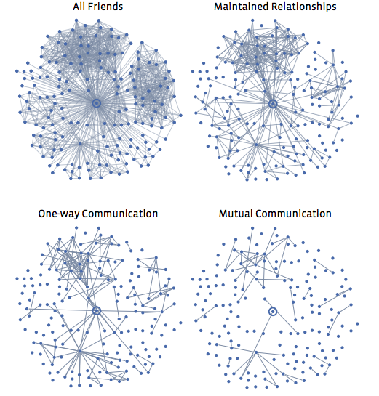
Types of connections
Strong Ties vs Weak Ties
Notes:
[granovetter’s concept]
Can use the ‘clustering coefficient’ here (probability that a node’s friends are friends)

Slide 49
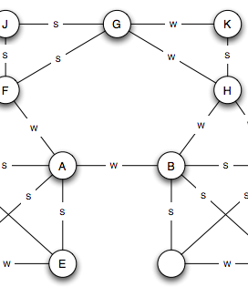
Types of connections
Strong Ties vs Weak Ties
Bridges & Local Bridges
Notes:
an edge joining two nodes A and B in a graph is a bridge if deleting the edge would cause A and B to lie in two different components.
if deleting the edge would increase the distance between A and B to a value strictly more than two == local bridge (span is new distance)
Bridging is essentially a form of social capital

Slide 50
Example (Onnela, 2007)
Cellphone data of 20% of a nation
Who talks to whom (network) and how long (tie strength)
a single connected component containing most (in this case 84%) of the individuals in the network
VERY FEW local bridges. Instead as a proxy, used neighborhood overlap (neighbors of both of 2 nodes / either)
Notes:
Talk about sampling: the lack of a central directory means that cell-phone numbers are generally exchanged among people who already know each other, the underlying network can be viewed as a reasonable sampling of the conversations occurring within a social network representing a significant fraction of one country’s population
0 neighborhood overlap = local bridge

Slide 51
Findings
Overlap increases with tie strength
Deleting strong ties doesn’t change the network structure much
Deleting weak ties changes structure much more quickly.
Notes:
Talk about sampling: the lack of a central directory means that cell-phone numbers are generally exchanged among people who already know each other, the underlying network can be viewed as a reasonable sampling of the conversations occurring within a social network representing a significant fraction of one country’s population
0 neighborhood overlap = local bridge

Slide 52

Designing networks
Whole books on the social science behind network design
Kraut, R. E. & Resnick, P. (2012). Building successful online communities: Evidence-based social design. Cambridge, MA: MIT Press.
Notes:
Example: making people feel like they are part of a group (even giving strangers the same t-shirt to wear) can change their behavior

Slide 53
Summary
Networks show up all the time in data analysis
Key metrics explore structure, influence, and network evolution (over time)
Introduced a new type of distribution common to networks: power law distribution
arises from the feedback introduced by correlated decisions across a population

